Slide 1
AI Study Buddy – Week 2
Team Project - MSc Computer Science
Anika Mayesha – D24125187
Lorenzo Palleschi – D24126922
Rumaysa Babulkhair – D24125711
Yurii Sykal – C23512523

Slide 2
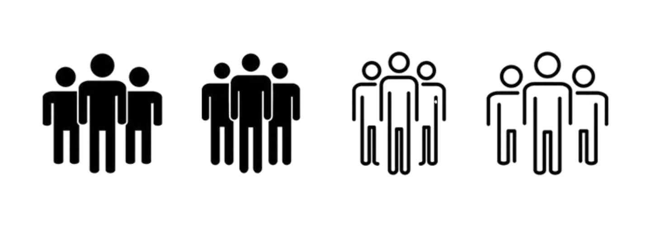


Personas
• Semi-fictional way for us to represent various student types.
• Makes the target users more relatable and human.
• Great for highlighting pain points and frustrations
• Helps to prioritise features and support.

Slide 3
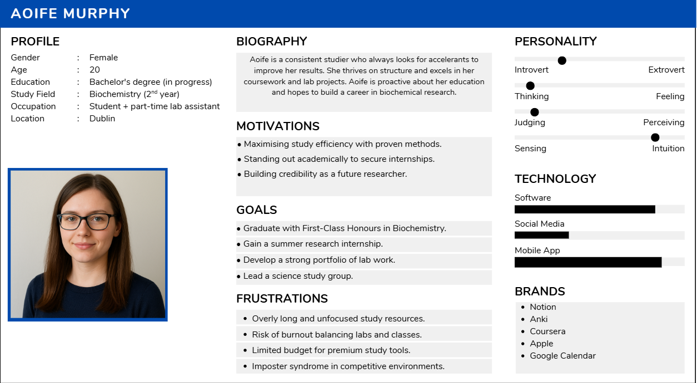
Persona 1 – The Consistent Studier

Slide 4
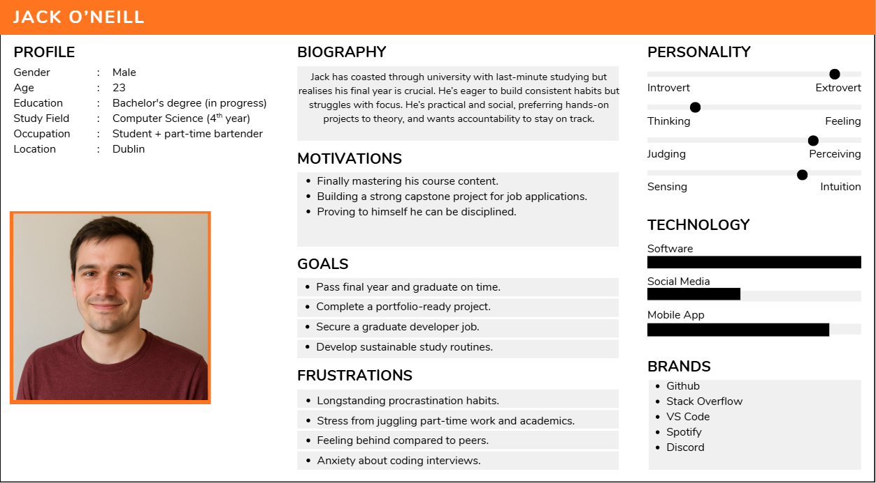
Persona 2 – 4th Year Coaster

Slide 5
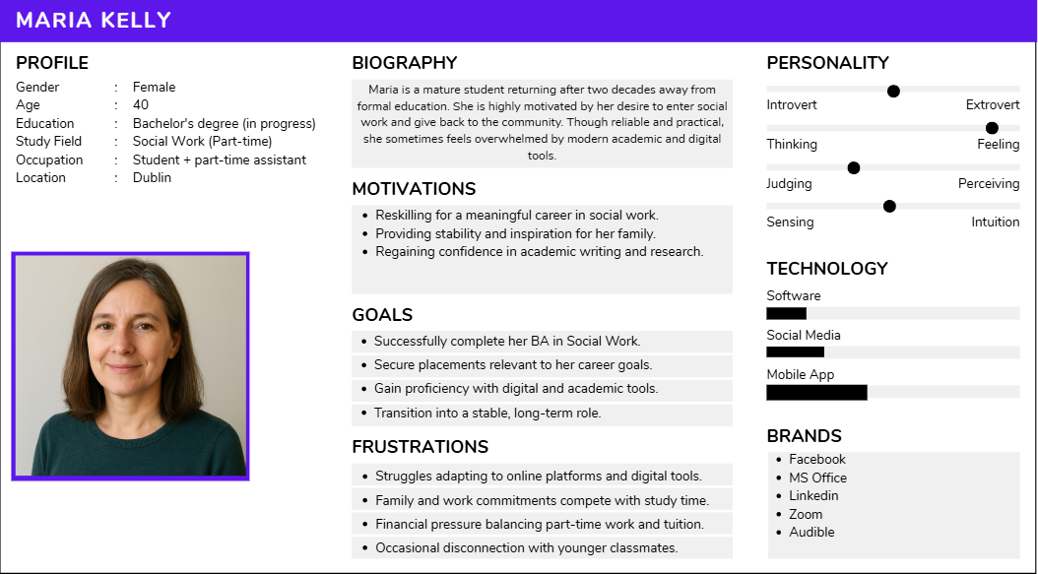
Persona 3 – Mature Student

Slide 6
Use-Case (Figma)
This use-case shows how a student would interact with the current iteration of AI Study Buddy.
Figma allows us to visualise our thought process and allows for substantially easier and accurate prototypes to be created.
With a step-through of the journey, design choices and features are easier to understand before development.

Slide 7
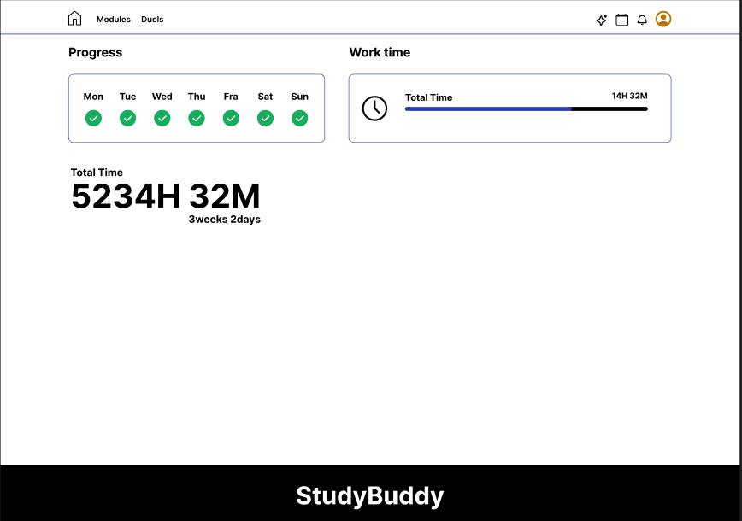
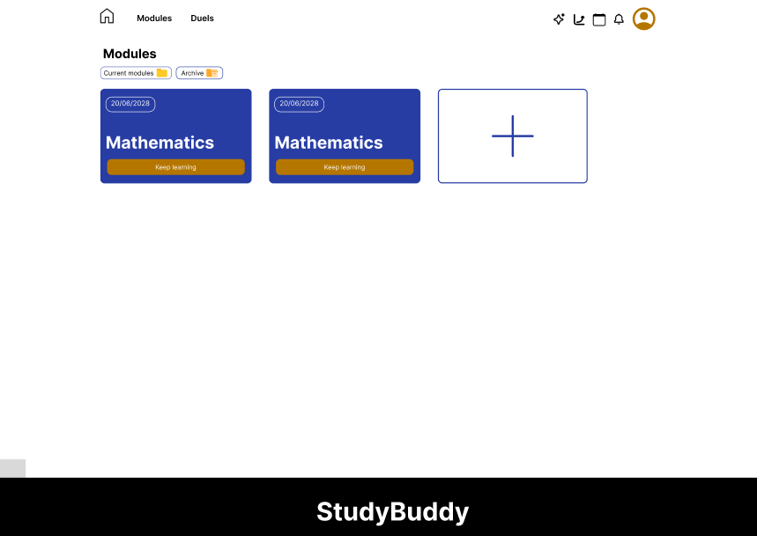
Homepage and Modules

Slide 8
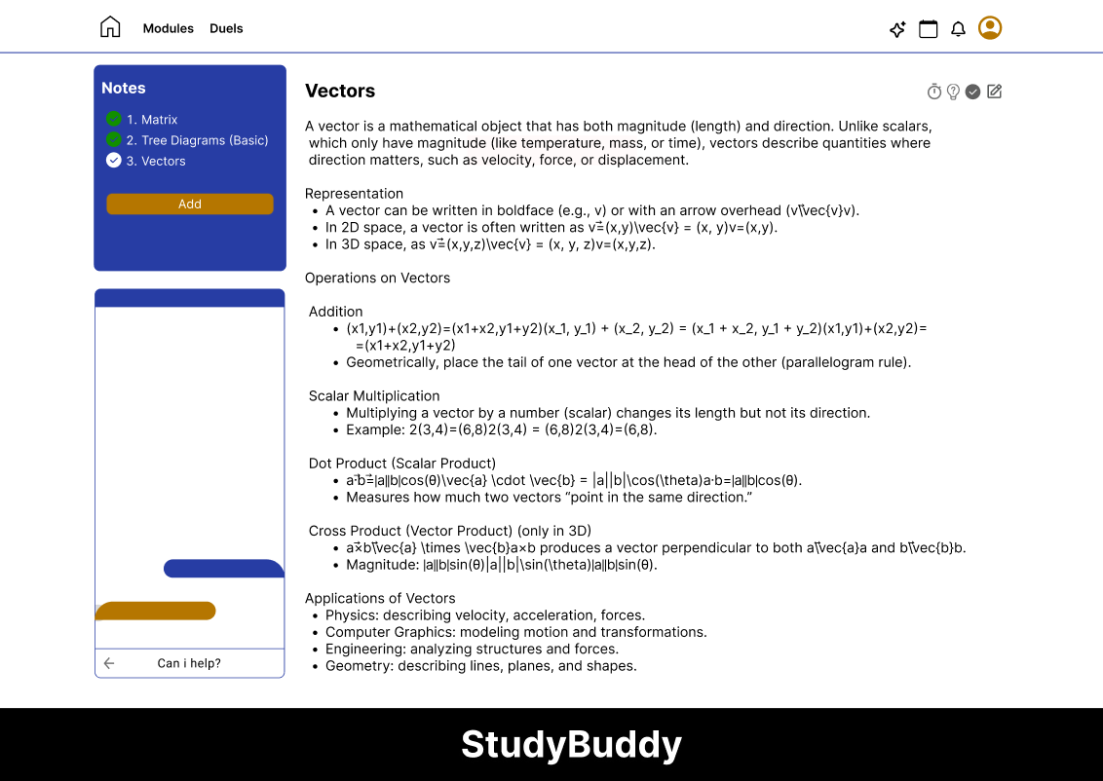
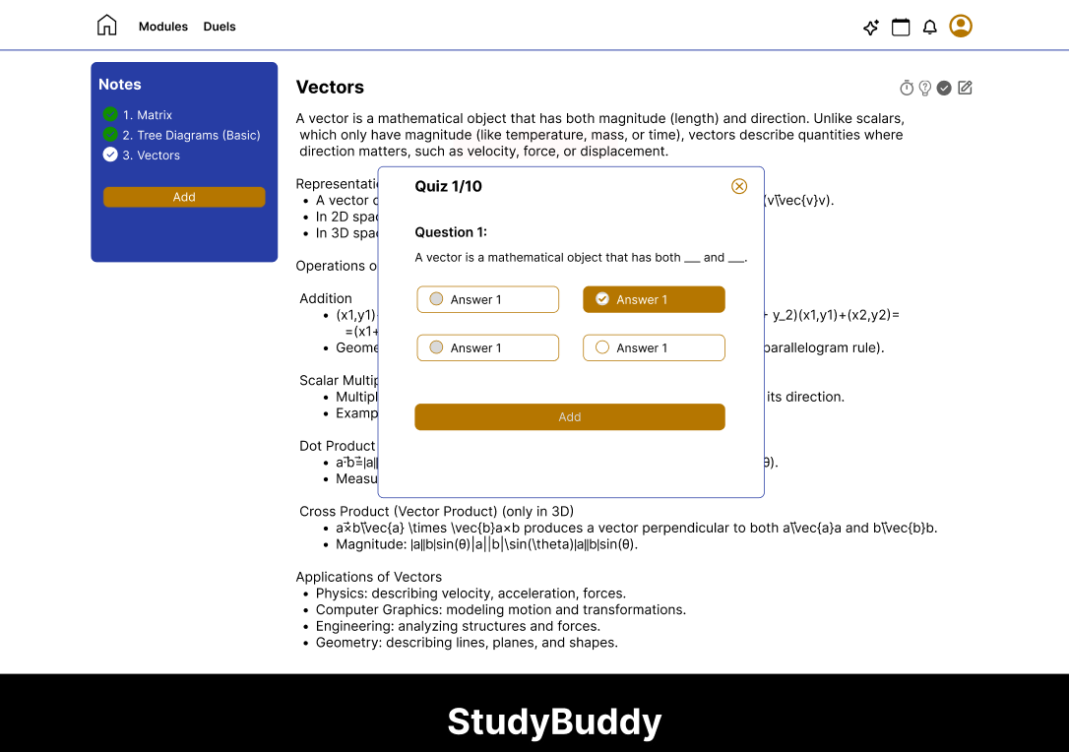
Mathematics and Quizzing

Slide 9
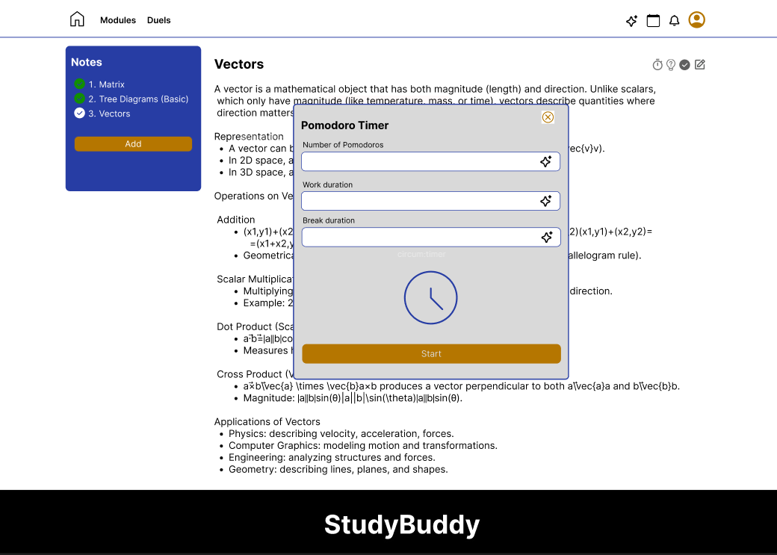
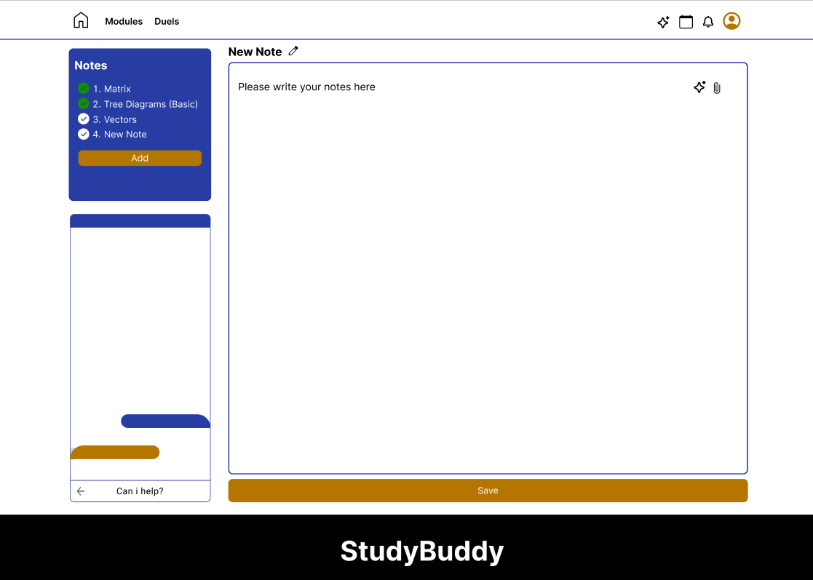
Pomodoro and Notes

Slide 10
Thank You
Any Questions?

